Slide 1
Training the Neural Network Model
The best values of weights and biases to be identified.
This is done called as the training phase.

Slide 2
Forward and Backward Propagation
Forward propagation: We work forward through the network producing an output result for a current given input from the dataset. A loss function is then evaluated that tells us how well the network did at predicting the correct outputs.
Backward propagation: We work backward through the network calculating the impact each weight had on producing the current loss of the network.

Slide 3
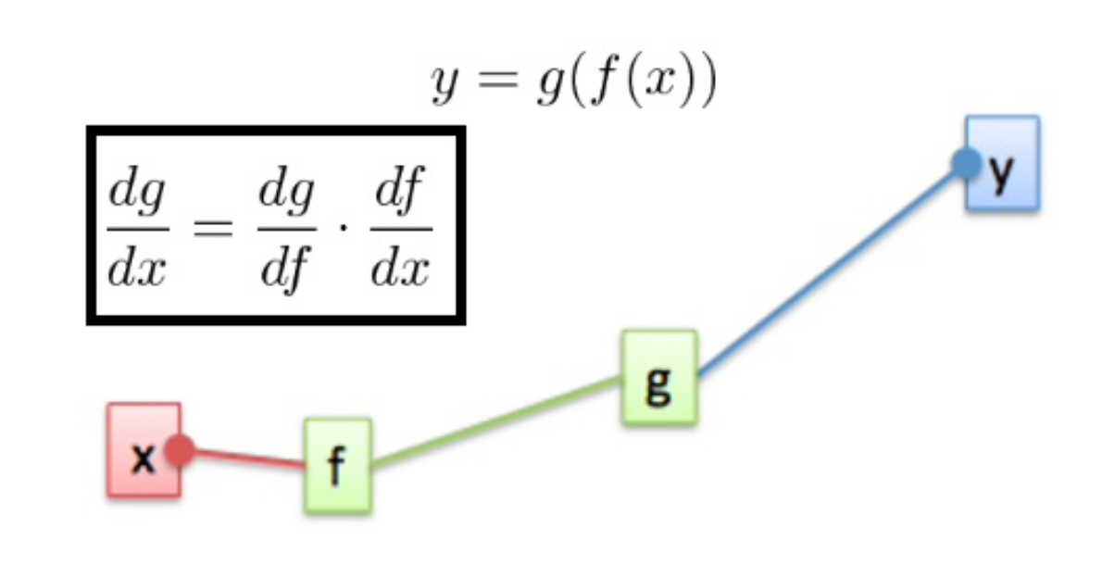
Backpropagation and the chain rule
If you want to know the influence of x on the function g, we just multiply the influence of f on g by the influence of x on f

Slide 4
Batches
During training, they divide the dataset into small pieces, named mini batches (or commonly just batches). Then, in turn, each mini batch is loaded and fed to the network where the backpropagation and gradient descent algorithms will be calculated and weights then updated. This is then repeated for each mini batch until you have gone through the dataset completely.

Slide 5
Loss functions
Log Loss - Classification tasks (returning a label from a finite set) with only two possible outcomes
Cross-Entropy Loss - Classification tasks (returning a label from a finite set) with more than two outcomes
L1 Loss - Regression tasks (returning a real valued number)
L2 Loss - Regression tasks (returning a real valued number)

Slide 6
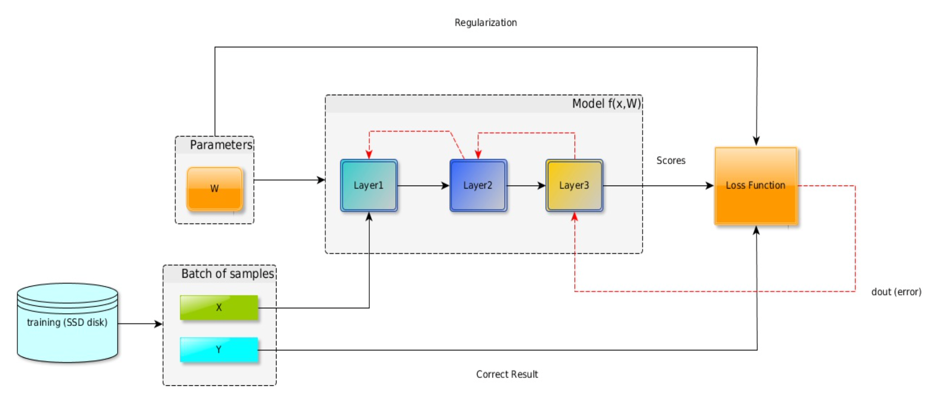

Slide 7
The optimizer and its hyperparameters
Gradient descent with momentum
RMSProp
Adam

Slide 8
Underfitting versus overfitting
When designing a neural network to solve a specific problem, have to take care of:
Preparing your dataset
Choosing the number of layers/number of neurons
Choosing optimizer hyper-parameters

Slide 9
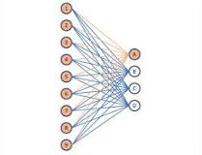
Fully connected layers
A fully connected layer refers to a neural network in which each input node is connected to each output node.
In a convolutional layer, not all nodes are connected.

